Slide 1
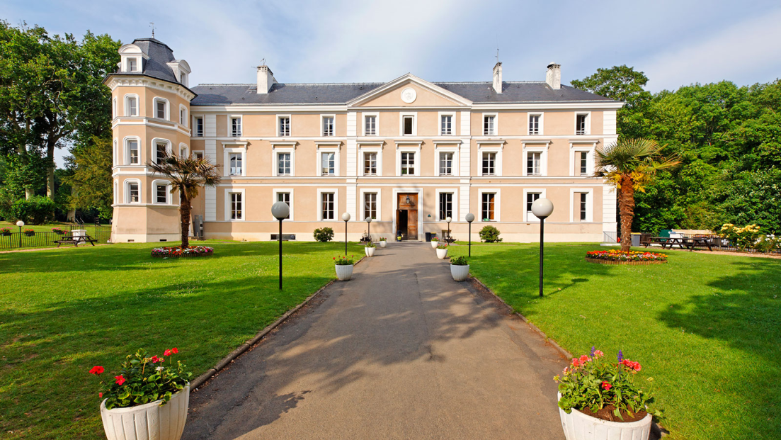
Year 6 PGL Information Evening
The 2024 Team
Mrs. Kelly
Mr. James
Mrs. Thompson
Mrs. Van Zyl
Mr. Kelly
Year 6: Paris
₃₁st _{March – 4}^{th} _{April}
2025
Support Members
Will James
Louis Colletta
Château de Grande Romaine, 77150,
Lesigny, Paris,
France

Slide 2
52 children (29 boys and 23 girls)
Adult to child ratio: 1:10
We have been to this site before.
Risk Assessments have been completed.
All PGL staff are DBS checked.
There is twenty-four hour security with CCTV.

Slide 3
First Aid
There is first aid on-site which has links with local facilities.
We are all trained in Emergency First Aid.
If you have stated on the medical form that your child requires medication, please send it in to Mrs Van Zyl and Mr Kelly. Mrs Brown will be organising all first-aid and medical needs before the trip. Please make sure it is labelled clearly.
On the trip, Mrs Kelly will take care of any medical needs based on the medical forms handed in.

Slide 4
Behaviour
Children will be spoken to regarding behaviour expectations.
Please talk to your child about what you as a parent expect from them in terms of behaviour.
Children are generally very well behaved as we are always busy and having a good time.

Slide 5
Safety
Children will be spoken to regarding procedures for safety and security.
Please talk to your child about how to keep themselves safe.
We have a thorough risk assessment that has been devised in conjunction with both French and English government guidelines. In addition, we have consulted with PGL, the coach company and the Eurotunnel.

Slide 6
Spending Money
We suggest no more than €20 per child.
Please instruct your children NOT to borrow or share their money. (However much money the children bring it is their responsibility to care for it)
Bags
Children should pack their bags and be able to carry them (wheelie bags are the best).
Please label the bags clearly.
Water bottle – Named and water-tight. (ESSENTIAL)
Children must have a backpack for day activities and travel.
Packed lunch
Your child will need a packed lunch in a disposable bag on the Monday we leave (and plastic shop-bought drinks).

Slide 7
Phones – Phone calls and text messages from parents do more harm than good.
NO PHONES
NO ELECTRONICS
YES DISPOSABLE CAMERAS
YES CARD GAMES, MAGAZINE, BOOK, DIARY
Kit list
You have been given a kit list however, the following items are often forgotten:
sensible outdoor shoes, waterproof jacket,
sun cream and lip balm, sun cap, a warm cap and gloves, hair bands for long hair, warm socks and underwear, pyjamas.
Check the weather on the weekend before we leave.

Slide 8
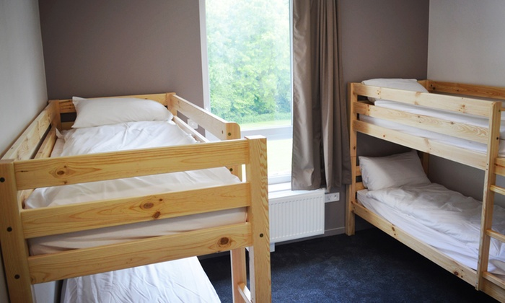
Accommodation
There are 4 accommodation blocks on-site
2-6 children in a room.
Staff are spaced out between children's rooms with occupants’ names on the doors.
Doors lock when closed, however can be opened from the inside. Teachers are in possession of master keys.

Slide 9
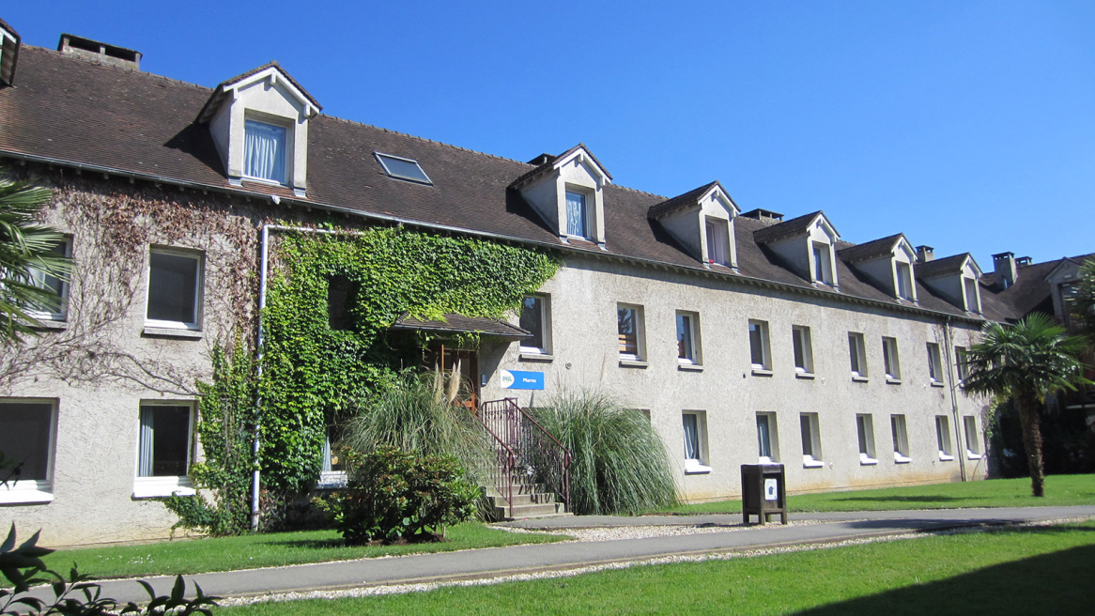
Children will organise their own groups for sleeping (with guidance from teachers).
Day groups will be organised by the staff but with input from the children.
Every effort is made for the children to be with their friends however, chances are that different friendship groups will be combined to make the numbers work.

Slide 10
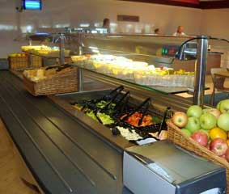
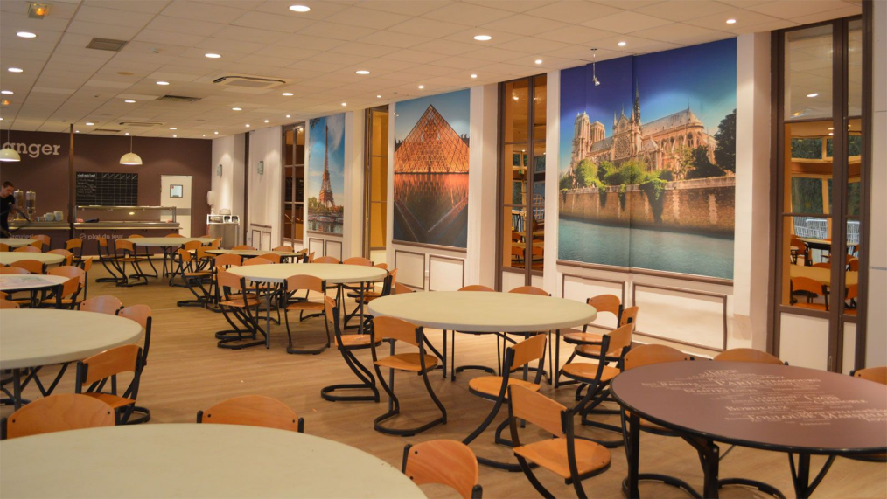
Food
Even the fussiest child is catered for!

Slide 11
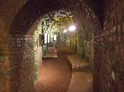
Monday
Arrive at St. Joseph’s Hall at 5:00am. Children will be registered, tagged, passports and GHIC cards collected. Please label your child’s luggage. The coach will leave school at 5:30am. Passports must not be in any kind of cover or holder. Money must be stored in a secure purse/ wallet in the main luggage.
Morning snack (brunch) at about 10:30am and lunch at about 2pm. Please pack accordingly – Your child will need a packed lunch in their day pack on Monday. Please use a
disposable bag and no fizzy drinks.
En route visit to the Arras tunnels or
Wellington Quarry. Drinks in the square.
Arrive at Château de Grande Romaine,
dinner and on-site evening entertainment.

Slide 12
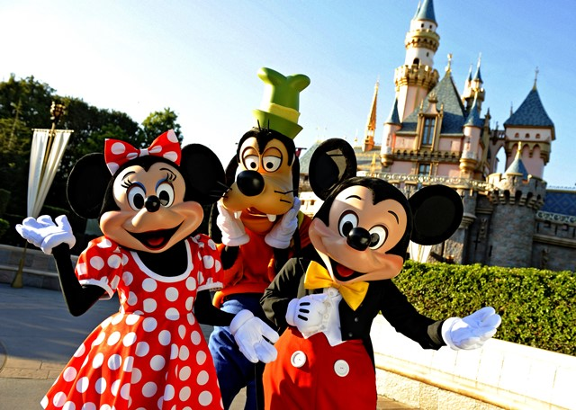
Tuesday
Disneyland Paris
A whole day visit to this Park
This trip has been paid for by the school and last year’s Y6 fundraising efforts.
Disneyland Paris is an entertainment resort in Marne-la-Vallée, 20 miles east of the centre of Paris. It’s the most visited theme park in all of Europe.
Dinner and on-site
evening entertainment

Slide 13
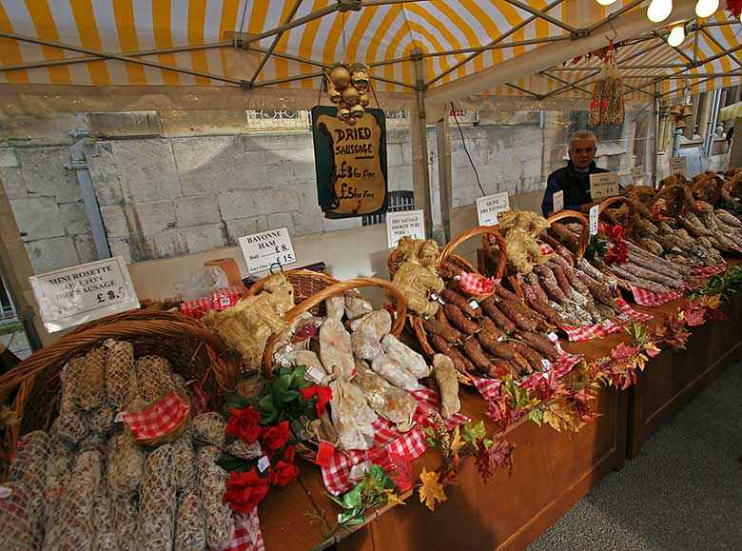
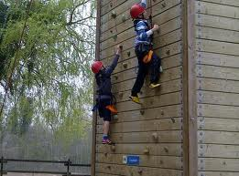
Wednesday
Breakfast
Visit to small local market at Melun to buy ingredients for lunch
Préparer a manger
competition
Lunch
Bowling at City Bowling d’Oz
Dinner
On-site activities

Slide 14
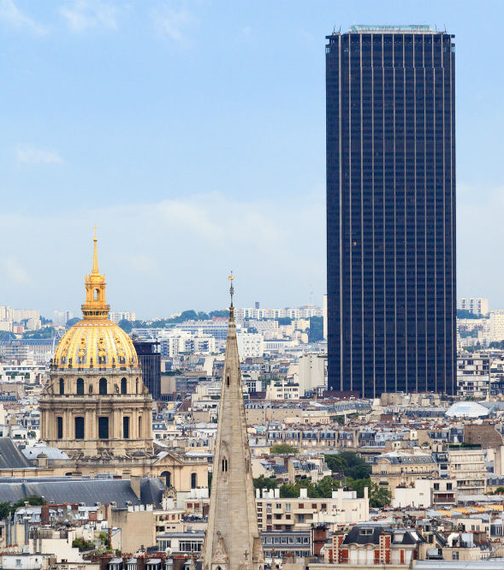
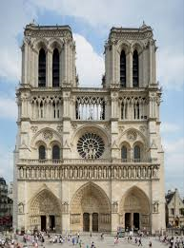
Thursday
Breakfast
Coach to Paris:
Tour Montparnasse
Tour Sacré Coeur and Montmartre
Picnic lunch
Return to centre, dinner and on-site entertainment

Slide 15
Return to UK
We aim to arrive back at school between 5:30 and 7:30pm.
We will send a parent mail once we are on the ferry in Calais to give an estimated time of arrival at school. Further updates will be posted on parent mail.
When you pick up your child, could you please see your child’s group leader so that your child can say thank you and we can return his/her passport.

Slide 16
Staying in touch
During the week we will provide you with regular
updates on Parent mail. Please don’t expect to hear from us for the first time until very late on Monday night.
Photos will be put on the website – hopefully daily.

